Slide 1
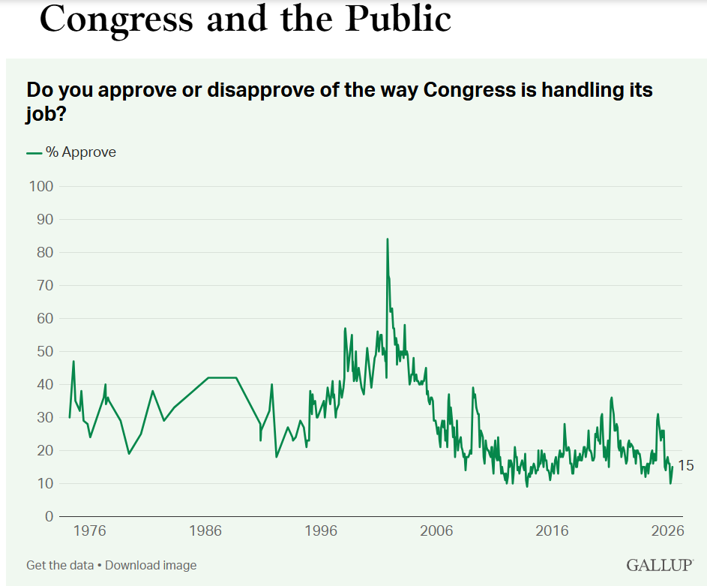
United States Congress
Current Status:
https://www.google.com/search?q=MTG%2C+AOC+%26+Jasmine+Crockett+trade+insults+at+House+Oversight+Committee+hearing+%7C+LiveNOW+from+FOX+(youtube.com)&rlz=1C1UEAD_enUS959US959&oq=MTG%2C+AOC+%26+Jasmine+Crockett+trade+insults+at+House+Oversight+Committee+hearing+%7C+LiveNOW+from+FOX+(youtube.com)&gs_lcrp=EgZjaHJvbWUyBggAEEUYOdIBCDEzNzVqMGo3qAIIsAIB8QVzkbn54ZkNGvEFc5G5-eGZDRo&sourceid=chrome&ie=UTF-8

Slide 2
United States Congress
https://gpb.pbslearningmedia.org/resource/civ23-soc-peoplesbranch/congress-the-peoples-branch-the-constitution-explained/
The U.S. Constitution designed a bicameral national legislature: a Congress composed of two separate chambers, the Senate and the House of Representatives.
Qualification to Run for Congress
  House of Representatives – Elected every two years
    At least 25 years old
    U.S. Citizen for at least seven years
    Inhabitant of the state he or she represents.
  Senate – Elected every six years
    At least 30 years old
    U.S. Citizen for at least nine years
    Inhabitant of the state he or she represents.

Slide 3
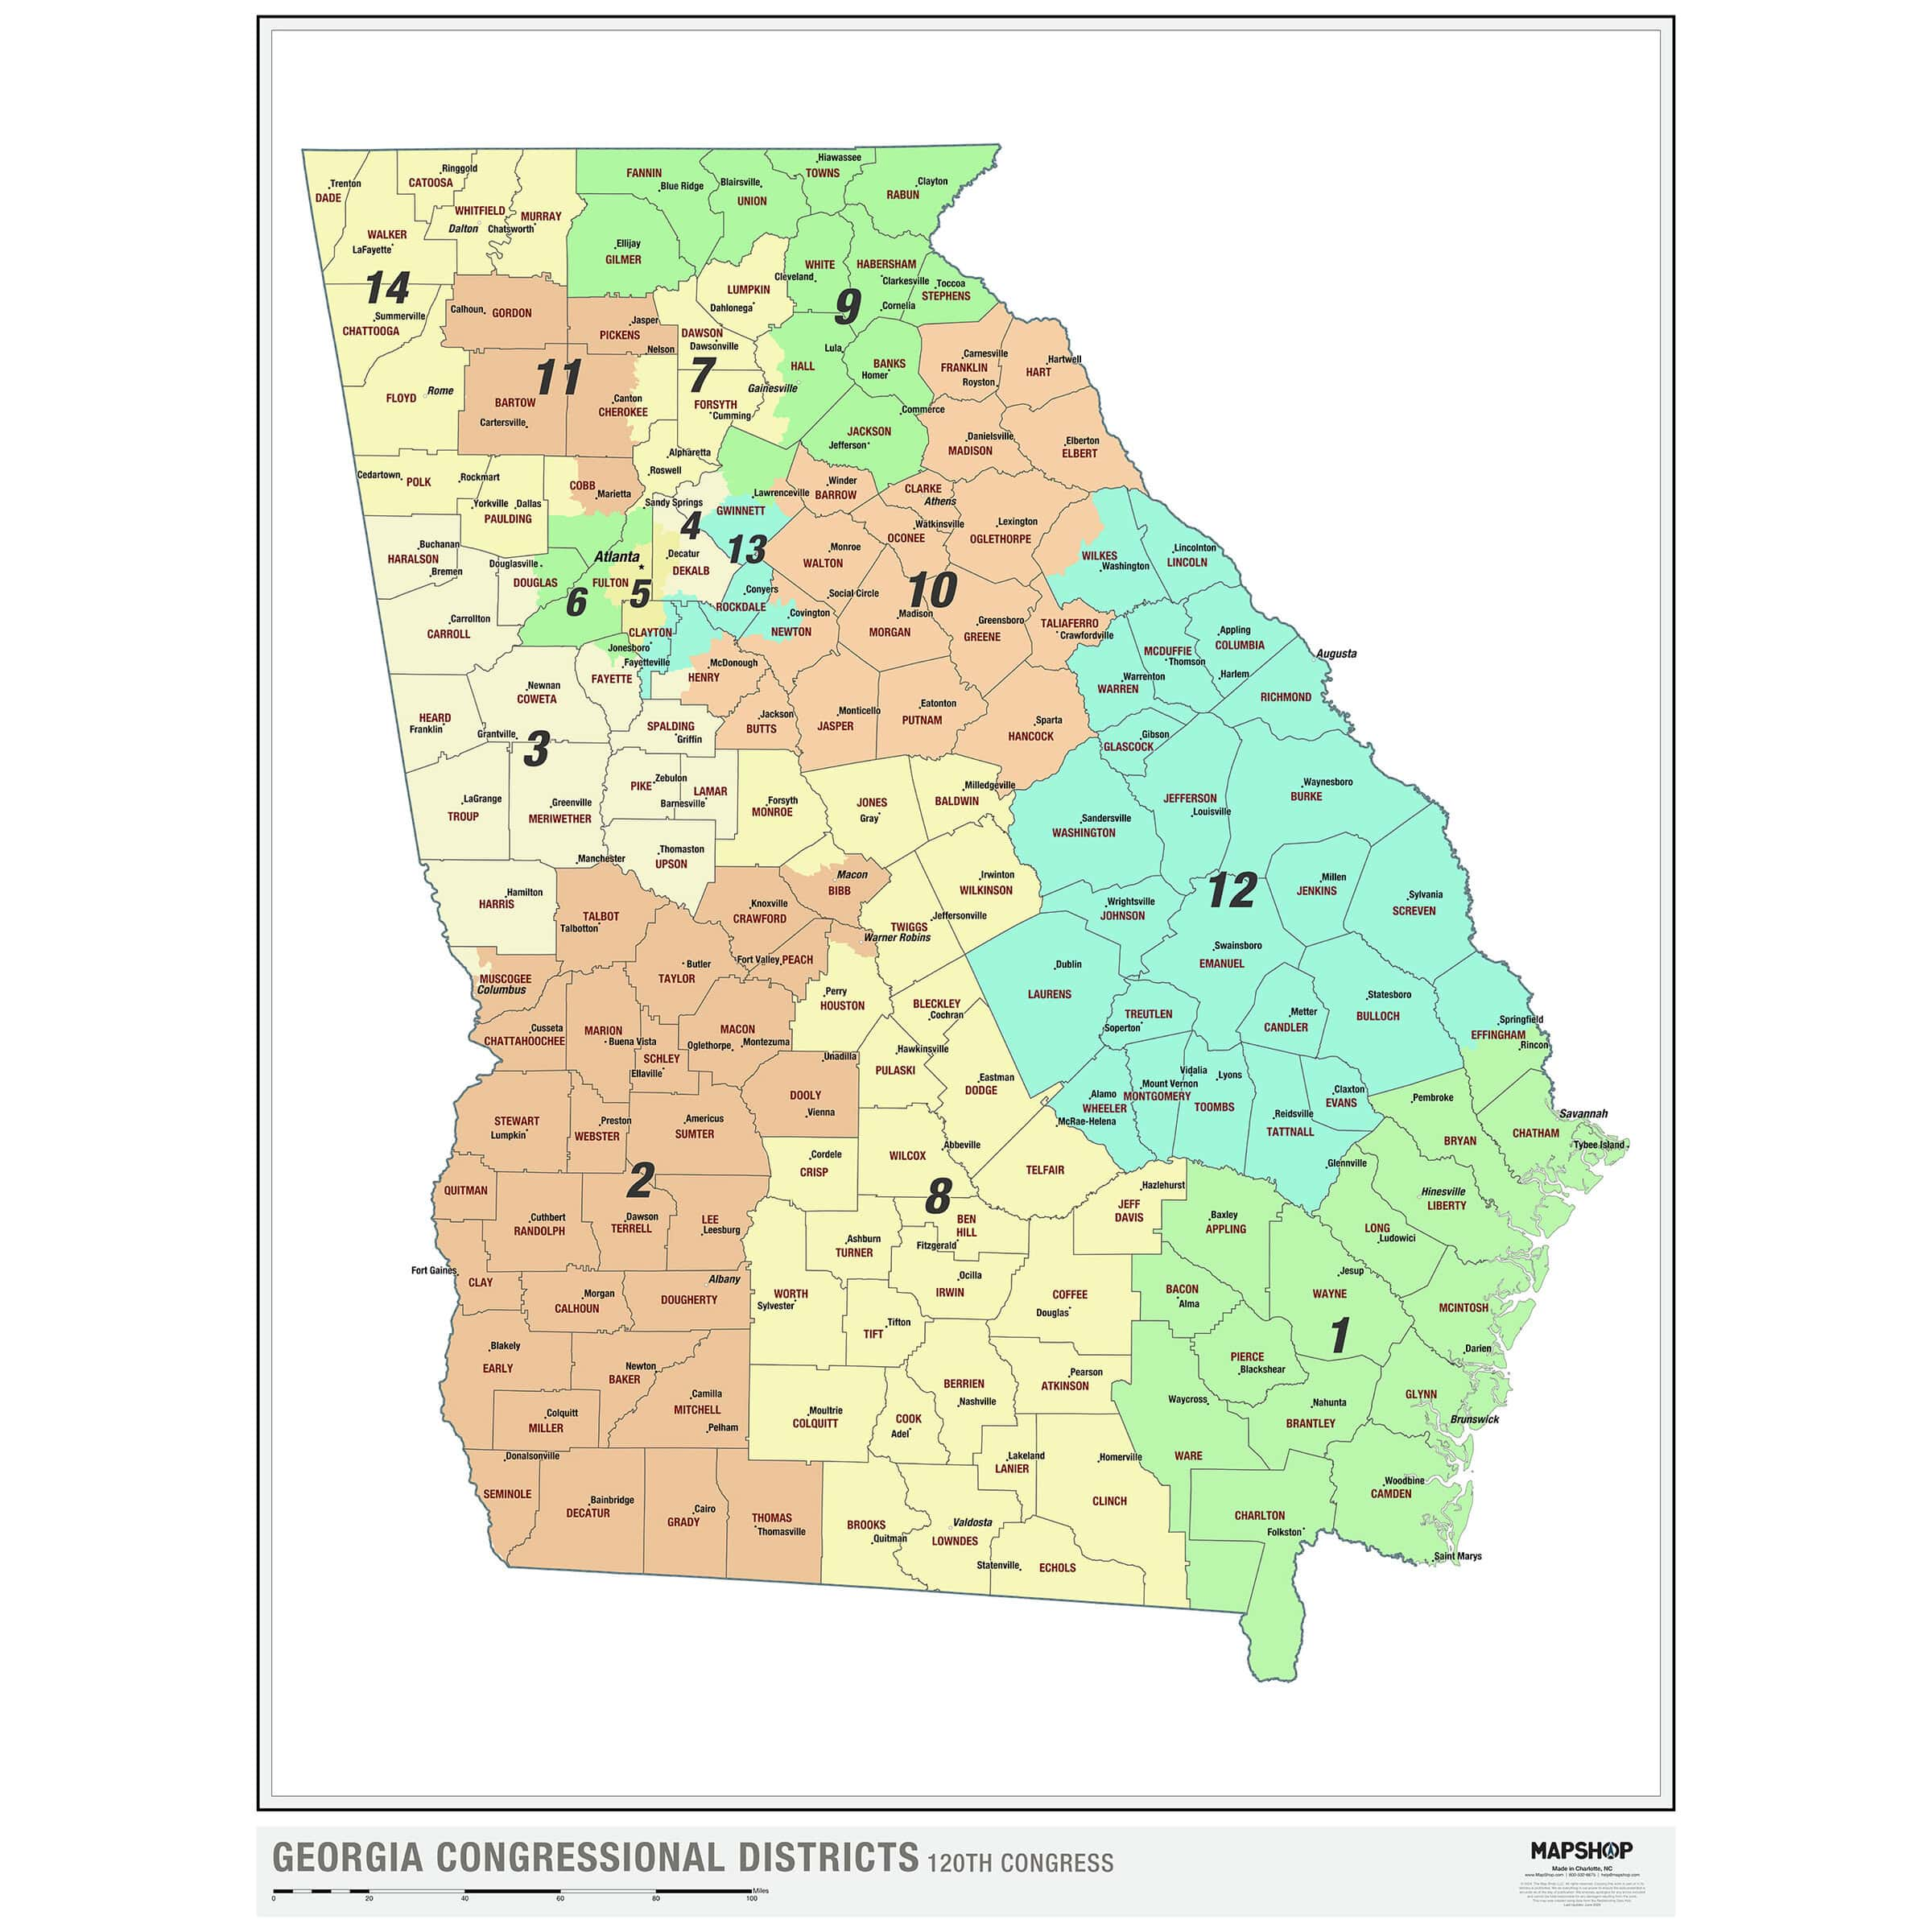

Slide 4
Congress – Constitutional Powers
Article 1: Constitutional Power for the Legislative Branch
https://www.youtube.com/watch?v=EZc0eCZi61Q
(only up to 4:31 minutes)
Power to tax and spend money “Power of the Purse”
Senate: Confirmation Power
    Recommended by the President, Confirmed by the Senate (majority vote)
      Cabinet, All Federal Judges (including the Supreme Court)
Borrow money
Power to Impeach (House: Resolution to Impeach, Senate: Trial)
To declare war, grant letters of marque and reprisal, and make rules concerning captures on land and water;
Investigate and to oversee the executive branch.
Impose and Adjust Tariffs - 1962 (Trade Expansion Act-”threat to national security”)
Power to raise an army and navy: (Airforce added)
Establish laws of naturalization
Establish lower courts
Necessary and Proper Clause – Elastic Clause
https://youtu.be/EsudHmV-B_Y

Slide 5
Division of labor in Congress: the House
The speaker is the most important leadership position, elected by all.
  Current Speaker: Rep. Mike Johnson
The majority leader holds considerable power and is in the best position to assume the speakership when the speaker steps down.
The minority leader is the official leader of the opposition.
  Rep. Hakeem Jeffries
The whips ”whip up” votes and otherwise enforce party discipline.

Slide 6
Division of labor in Congress: the Senate
Unlike the House, the Senate doesn’t have a speaker.
Instead, the Senate has majority and minority leaders and whips; majority and minority leaders hold power.
  Current Majority Leader: Sen. John Thune
  Current Minority Leader: Sen. Chuck Schumer
The Senate’s president is the elected vice president of the United States.
  Vice President JD Vance

Slide 7
The Speaker of the House
The most important leadership position in the House is that of the speaker, who is elected by the entire body.
The speaker is the presiding officer and head of the House, the partisan leader of the majority party in the House
  Constitution doesn’t say if the Speaker must be an elected member of the House.
  2nd in Line to be President (behind the Vice President)
The speaker serves until his or her party loses or until he or she is voted out of position or steps down.
The speaker appoints members and chairs to committees and can create select committees to fulfill his or her purposes and then disband them.

Slide 8
Types of congressional committees
Standing committees are permanent committees. They are the first call for proposed bills.
https://www.congress.gov/committees
Conference committees are used to reconcile different bills passed in both the House and the Senate. They are appointed on an ad hoc basis.
Ad hoc committees, also called special or select committees, are temporary committees set up to address specific topics. These types of committees often conduct special investigations.

Slide 9
Gerrymandering and apportionment of seats
Gerrymandering is the manipulative dividing of election district boundaries to give majority advantage to one party.
Congressional apportionment is achieved through the equal proportions method, which uses a mathematical formula to allocate seats based on U.S. Census Bureau population data, gathered every ten years as required by the Constitution.
Historically Every Ten Years to Coincide with the Census.

Slide 10
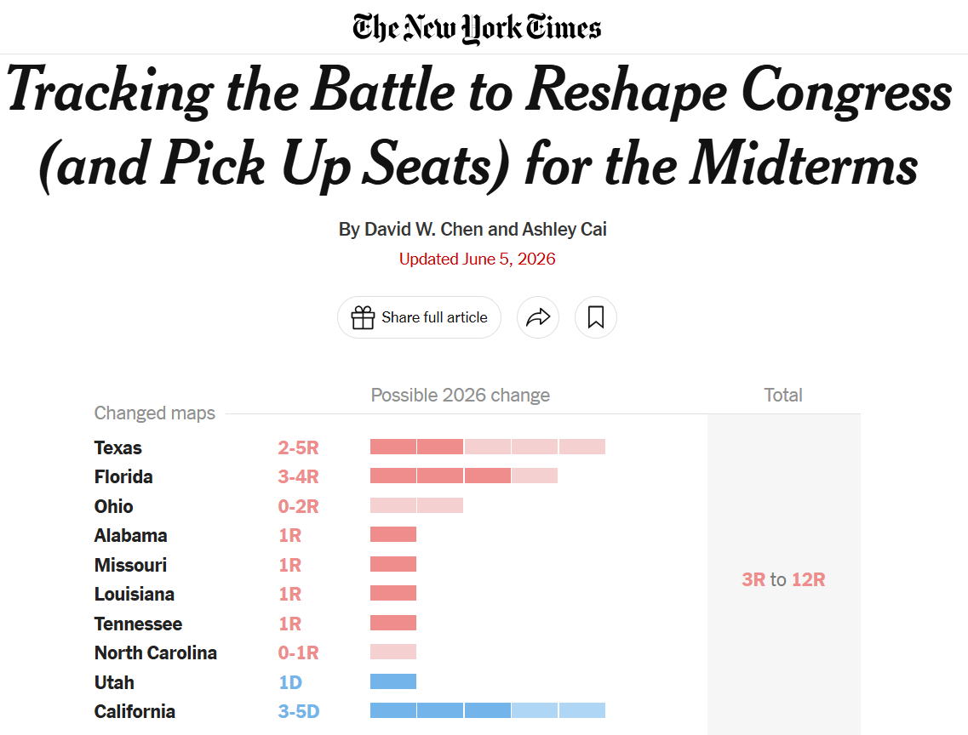
2025 – 2026 Redistricting
Last Time Redistricting between Census for Political Reasons: 2003 (Texas)
https://youtu.be/pbOFFpH27io
Bing Videos

Slide 11
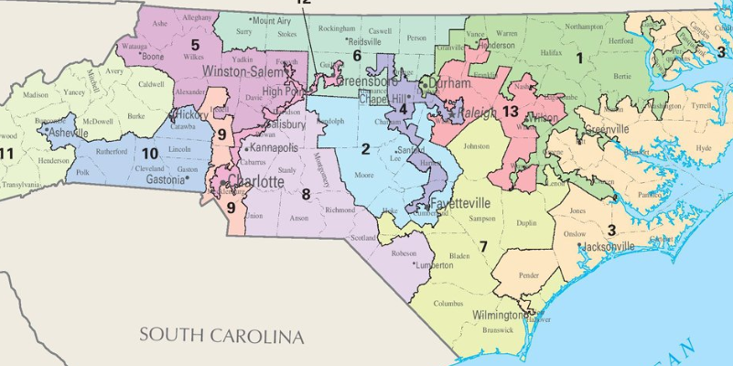

Slide 12
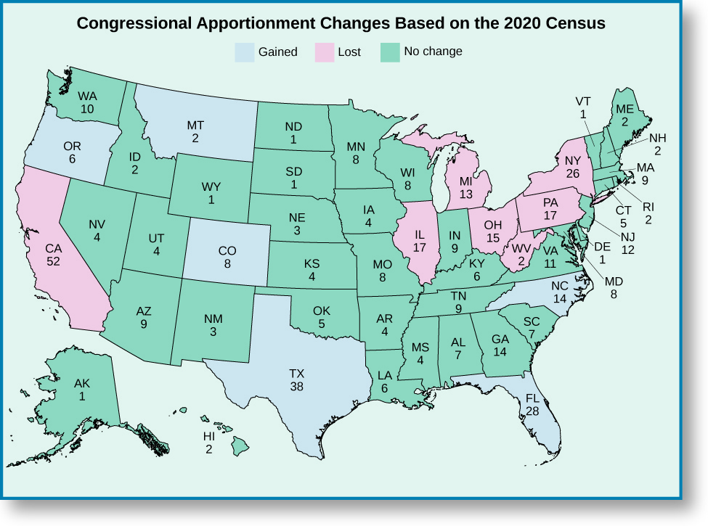
Figure 11.3
Although the total number of seats in the House of Representatives has been capped at 435, the apportionment of seats by state may change each decade following the official census. In this map, we see the changes in seat reapportionment that followed the 2020 Census.

Slide 13
Budget, Debt and the Fillibuster
Budget
Must pass a budget by September 30
12 Appropriation Bills
Last time Congress Passed a Budget on Time?
Budget Year – October 1 to September 30
What is a Continuing Resolution?
December 11th
National Debt
https://www.foxbusiness.com/video/6403779268112
  What is causing the National Debt
Fillibuster
https://youtu.be/y_0DRy1NSl0?si=wK_ULv3obyVb40fG
Cloture
Nuclear Option
2013 (Democrats): Led by Majority Leader Harry Reid, Senate Democrats lowered the threshold to a simple majority for executive branch and lower federal court judges after facing heavy blockades on nominees.
2017 (Republicans): Senate Republicans extended the nuclear option to Supreme Court nominations to confirm Neil Gorsuch.
2019 (Republicans): Republicans used it again to reduce floor debate time for lower-level nominees.
Budget Reconciliation
https://www.bloomberg.com/news/videos/2025-05-12/how-budget-reconciliation-works-in-congress-video

Slide 14
The executive Power shall be vested in a President of the United States of America.
Article 2, Section 1: U.S. Constitution
https://youtu.be/w1UPkog5CrY
https://youtu.be/sl_gO3uOds8
* Article II Executive Vesting Clause does not limit the executive Power in any way.

Slide 15
Design of the executive branch
The president is a single executive elected by the Electoral College for four years and who is limited to serve two terms.
https://youtu.be/UkepSGMgC-E
    Winner Take All (except Nebraska and Maine)
        In Nebraska and Maine, whoever the number of electoral votes is determined in how many Congressional districts a candidate wins.
The chief executive must be at least thirty-five years old and a “natural born” U.S. citizen who has been an inhabitant of the United States for at least fourteen years.
Historic Evolution of the Presidency
  https://youtu.be/Jh8Qpa4Aazw
  min 2:00 to end

Slide 16
Powers of the Presidency
  Pursuant to the Oath of Office, will preserve, protect, and defend the Constitution of the United States.
Has the power to approve or veto bills and resolutions passed by Congress
  2/3rd vote in both the House of Representatives and Senate to Override a Veto
Commander-in-Chief of the United States military
  Only Congress can Declare War
  War Powers Act
    https://youtu.be/barQHoh3krc
    Current Situation: Iran
    https://www.c-span.org/clip/white-house-event/trump-says-he-doesnt-need-congress-authorization-to-continue-iran-war-beyond-60-days/5199801
  Declare State of National Emergency
  https://www.youtube.com/shorts/vB1xK7j5Nz4?feature=share
  Current Use of National Emergency
  https://www.nytimes.com/video/us/100000010351409/what-counts-as-a-national-emergency.html

Slide 17
Powers of the Presidency
Has the duty to see that the laws are faithfully executed.
Power to write checks pursuant to appropriation laws.
“Power of the Purse”
  “No Money shall be drawn from the Treasury, but in Consequence of Appropriations made by Law.”
  Power to Not Spend Money Appropriated by Law?
  Impoundment Act of 1974
  https://youtu.be/H7Q2q_AgMQY
  USAID
  https://youtu.be/LCw-YQYFJBA
  “Pocket Rescission”

Slide 18
Powers of the Presidency
Power of Appointment
  Shall appoint Ambassadors, Judges of the supreme Court, and all other Officers of the United States
  What are “Other Officers”
    Courts Interpretation: “exercising significant authority pursuant to the laws of the United States”. Examples: FBI, National Intelligence
Has the power to convene one or both houses of Congress during extraordinary occasions, and when Congress cannot agree to adjourn has the power to adjourn them when he thinks the time is proper.

Slide 19
Powers of the Presidency
Power to make treaties, with the advise and consent of the Senate. (2/3rd vote to approve)
Power to Create Executive Departments (creation of the Cabinet)
  Power to Pardon
  Limited to federal cases, treason yes, impeachment, no
  https://www.foxnews.com/video/6367469573112
  Bing Videos

Slide 20
Power of Executive Orders
https://youtu.be/oyOf3g-PJ94
Limits in Blocking Executive Orders
https://youtu.be/Nj_ZDMNC2Yc
Canvas assignment

Slide 21
Testing the Powers of the Presidency
Power to Declare a National Emergency
Bing Videos
Does the President Have the Power to Impose Tariffs?
Congressional Constitutional Authority, Article I, Section 8 of the Constitution
https://youtu.be/Zv0Dqrl3QV8
Does the President Have the Power to Withdraw from a Treaty?
NATO (North Atlantic Treaty Organization, 1949)
https://youtu.be/pjPkwSlgR4I
Does the President Have the Power to Deport Undocumented Immigrants Without Due Process?
Alien Enemies Act
https://youtu.be/GSDv6n26zGQ
Does the President Have the Power to send the military to the Southern Border or in times of unrest into States (ex. Los Angeles?)
Posse Act/1878 (No?)
https://youtu.be/FiETMImO6xw
  Insurrection Act of 1807 (yes?)
  https://youtu.be/X5Ztd7Aq_kg

Slide 22
Judicial System
"The judicial Power of the United States, shall be vested in one supreme Court, and in such inferior Courts as the Congress may from time to time ordain and establish.“
Qualifications and Term of Office
  "shall hold their Offices during good Behaviour.“
    Hold office as long as they want or impeached
  Nominated by the President
  Confirmed by the Senate – Majority Vote
  Constitution doesn’t set any qualifications, yet justices have either been a lawyer or studied law.
Path to the Supreme Court
  Act of 1789
  District Courts (Trial Courts)
  Circuit Courts (Court of Appeals)
  Expanded the Supreme Court Original Jurisdiction
https://youtu.be/ZQNLP1_Xmcw
Supreme Court: Constitutional Overview
  Appellate and Original Jurisdiction (Limited to Disputes between States, Ambassadors, Public Ministers)
  https://www.youtube.com/watch?v=39d9sdrDyXc

Slide 23
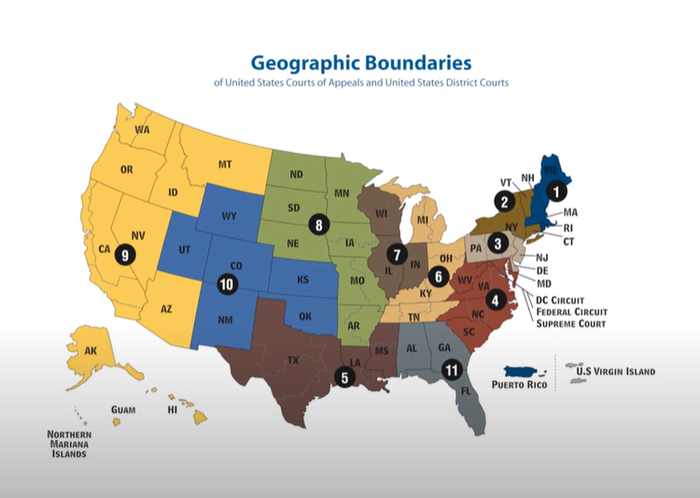

Slide 24
Section 2 of Article III of the U.S. Constitution details what cases the Supreme Court can hear:
Cases affecting ambassadors, other public ministers, and consuls
Admiralty and maritime cases
Controversies involving the United States, between states, between a state and citizens of another state, between citizens of different states, between citizens of the same state over land grants from different states, and between a state/citizen and a foreign state/citizen/subject

Slide 25
Supreme Court – Power of Judiciary Review
  Judiciary Act of 1789
      created new courts, added judges
      gave the president more control over appointment of judges.
      authorized the Supreme Court to issue writs of mandamus in cases brought directly to it
Marbury vs. Madison - 1801
https://youtu.be/Gbjv8pLMUVk
Supreme Court Decision 1803
  Not delivering the Commissions was illegal
  Yet, the Supreme Court could not force Madison deliver the Commissions.
        Marbury asked for a “Writ of Mandamus” for the Supreme Court to Orders government officials to fulfill their duties.
    Expansion of Original Jurisdiction in the Act of 1789 was unconstitutional because it was in conflict with the Constitution defined role of the Supreme Court

Slide 26
Chief Justice John Marshall
“If . . . the constitution is superior to any ordinary act of the legislature; the constitution, and not such ordinary act, must govern the case to which they both apply." Further, “a law repugnant to the constitution is void, and . . . courts, as well as other departments, are bound by that instrument."

Slide 27
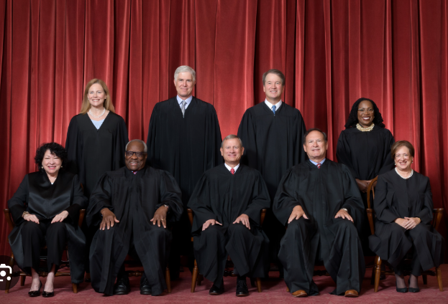
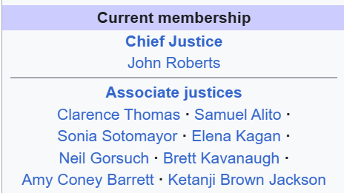
Current Members of the Supreme Court
Who are the justices on the US Supreme Court? - BBC News

Slide 28
Judicial Interpretation
Chief Justice and Associate Justices have distinct differences in how to use the Constitution to make decisions
  Originalists vs. Evolutionists
  “Who made you King?”
  https://youtu.be/VGKgJdW55nc
  0 to 11:50 mins
  Examples of Originalists vs. Evolutionists
    West Virginia v Environmental Protection Agency
    https://youtu.be/JOUDwm6DOkI
    Kennedy v. Bremerton School District
    https://youtu.be/OE2jckwSoJc
    Dobbs v Jackson Women's Health Organization
    https://youtu.be/mQllmb-0Lnk
  Trump v. United States
      https://youtu.be/84DgYV6HtBo

Slide 29
Stare Decisiss
the legal principle of determining points in litigation according to precedent
Latin, literally ‘stand by things decided’

Slide 30
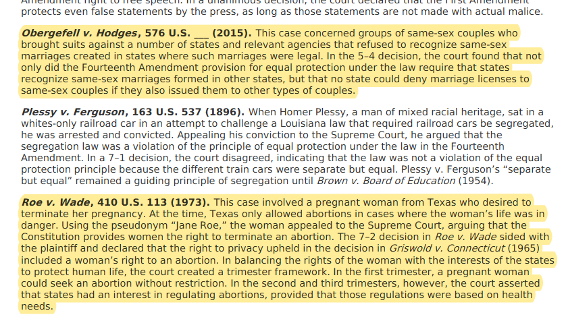
Historic Supreme Court Cases

Slide 31
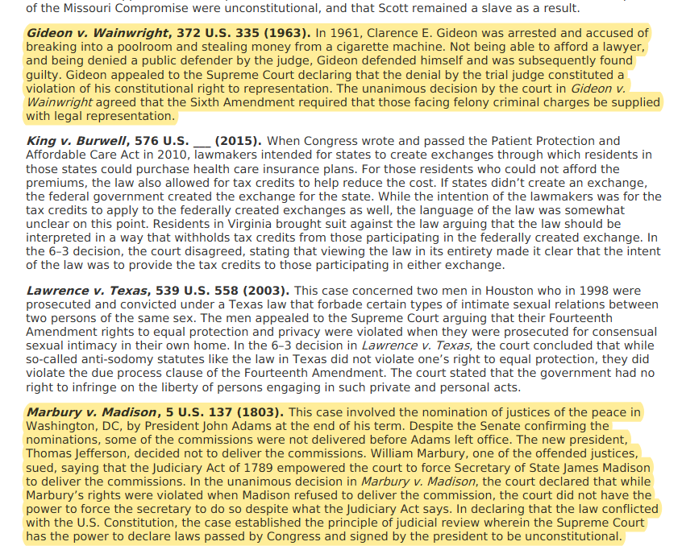

Slide 32
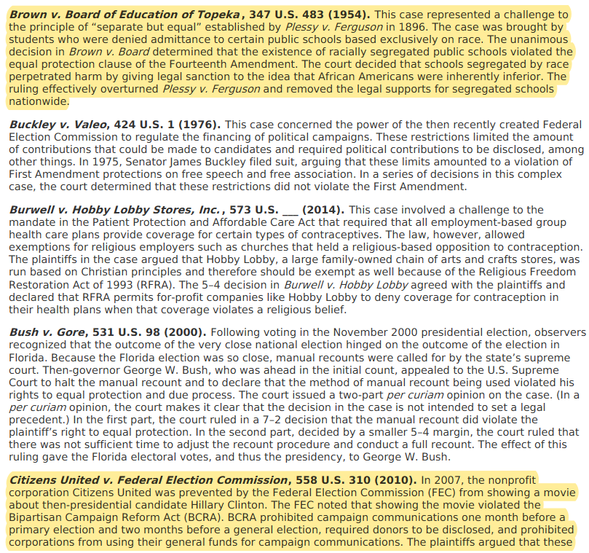

Slide 33
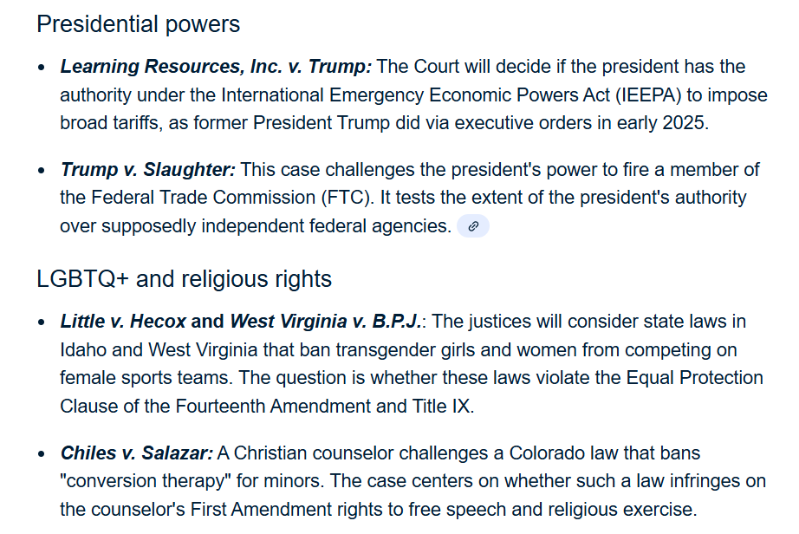
Supreme Court 2025-26: Key Cases
Began Oct. 6th, 2025
  Emergency Docket “Shadow Docket”
  https://www.c-span.org/clip/america-250/justice-barrett-on-the-shadow-docket/5175410
Decision
https://www.youtube.com/watch?v=lAJgRuZIexI
https://youtu.be/StorpCnJjck

Slide 34
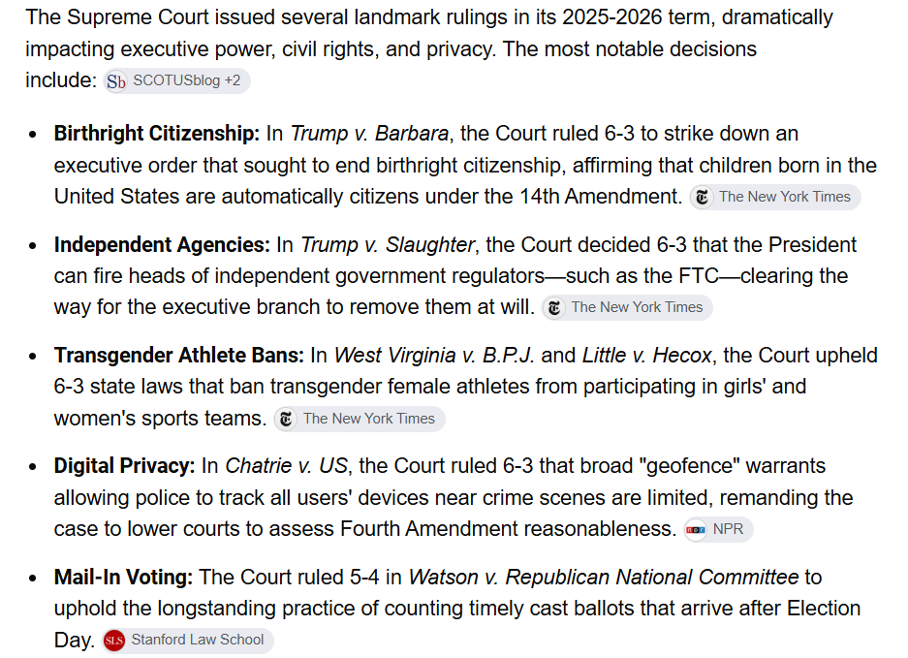
Supreme Court 2026: Key Decisions
Temporary Status Case
Overview (1 – 2.36, 10:45 – 16.04, 18.08 – 22:15, 22.15..)
Bing Videos
  Bing Videos
https://youtu.be/StorpCnJjck

Slide 35
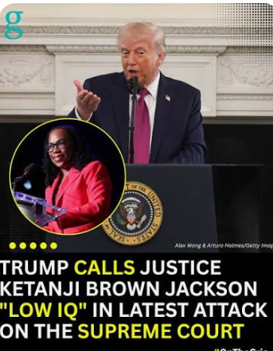
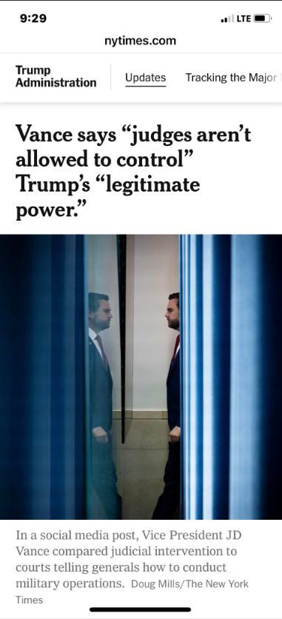
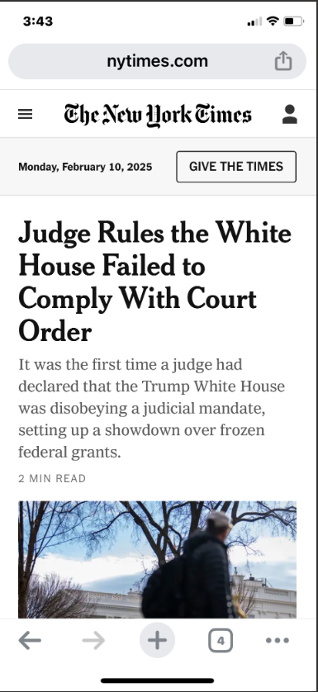
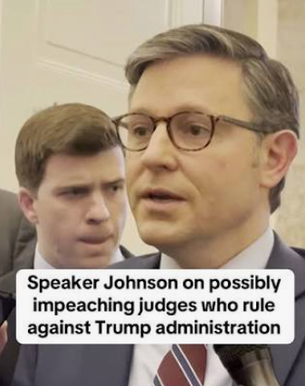
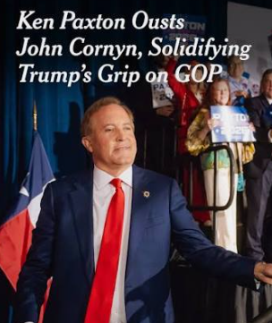
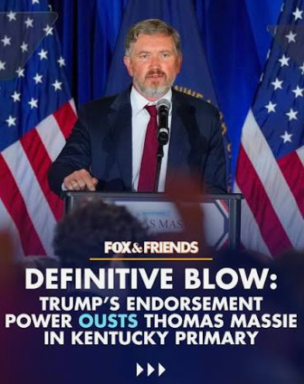
Checks and Balances?
  https://www.youtube.com/watch?v=3NTNbOmYYas&t=156s

Slide 36
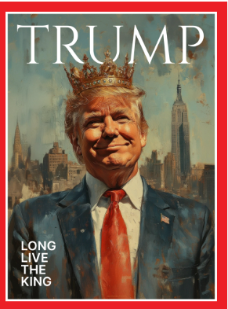
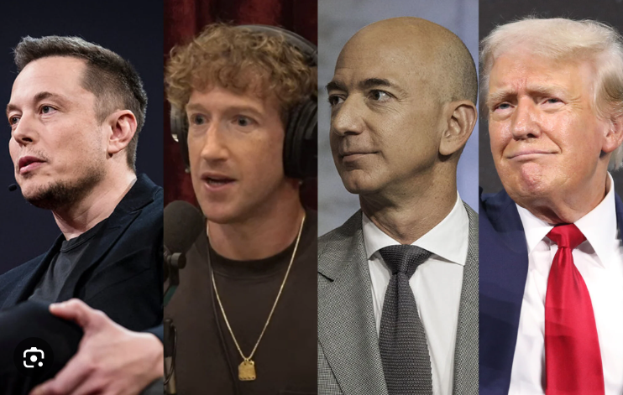
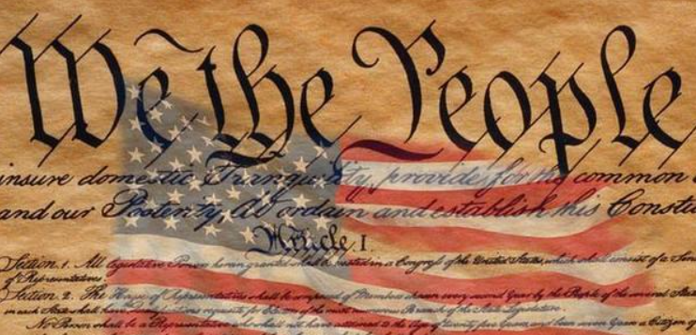
Do we have a Monarchy, Oligarchy,
a Republic
or
a “Monolipublic”?
How will the Supreme Court Ultimately Define the Role and Power of the Presidency?

Slide 37
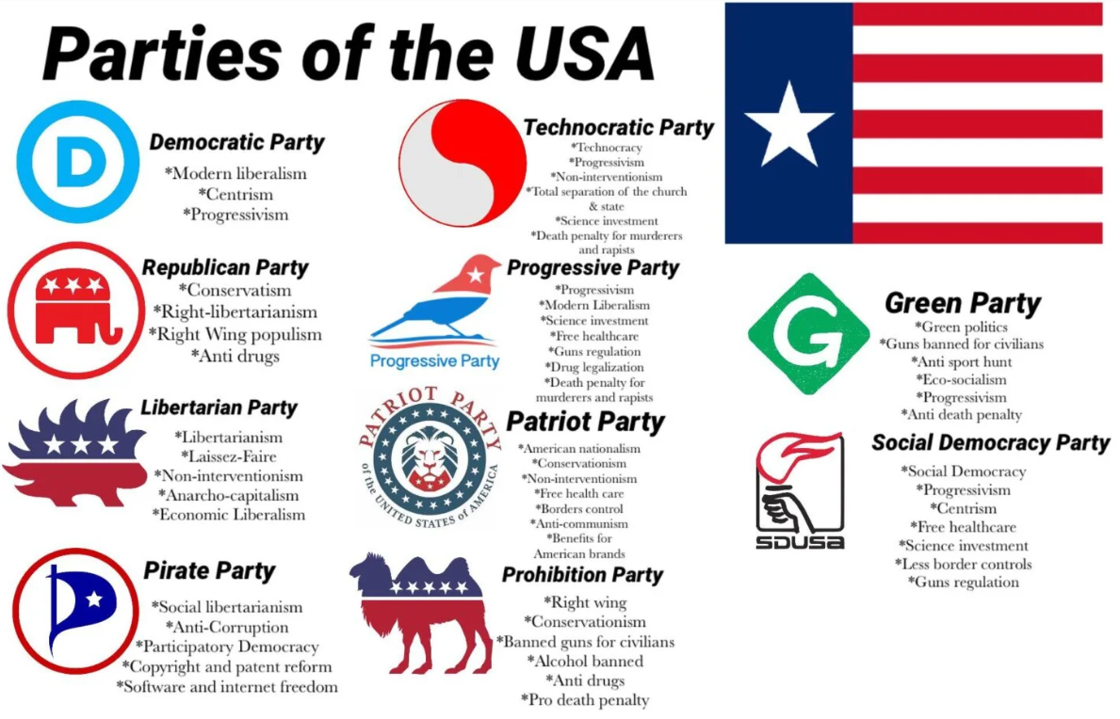
Political Parties
https://youtu.be/gdlN01Od3vI

Slide 38
Political Parties and What They Do
Political parties are groups of people with similar interests who work together to create and implement policies. They do this by gaining control over the government by winning elections. Their purpose is (but is not limited to):
drafting legislation
guiding proposed laws through Congress and informing party members how they should vote on important issues
nominating candidates to run for state government, Congress, and the presidency
coordinating political campaigns and mobilizing voters

Slide 39
Evolution of the U.S. Political Parties
Politics during the nation’s founding was at a local interest level as opposed to a national interest level.
The Revolutionary War led to the formation of the two original political parties: the Federalists, who preferred the idea of a stronger, more centralized republic; and the Anti-Federalists, who preferred a more confederate system built on state equality and autonomy.
https://gpb.pbslearningmedia.org/resource/arct14.soc.amexdoldel/the-emergence-of-political-parties-in-the-early-republic-american-experience/

Slide 40
Transfer of Power 2026?
  United States Senate
  53 Republicans, 47 Democrats/Independents
  To Control Senate (Democrats must pick up 4 seats)
    Vice President J.D. Vance breaks a tie
    13 Races to watch
  United States House of Representatives
  Set by law – 435 members
    Need 218 for a Majority
  Currently, 218 Republicans, 212 Democrats, 1 independent (4 vacancies)
  2026 Mid-Term Election
    Solid/Likely, (R) 200, (D) 193
    Lean/Toss-ups, 42
    To Control House of Representatives
        Republicans need 15
        Democrats need 25

Slide 41
Party Alignment and Realignment
Political parties exist for the purpose of winning elections in order to influence public policy. This requires them to build coalitions across a wide range of voters who share similar preferences and who might align themselves with a particular party if their preferences coincide with those of the party.
Depending on various factors, such as a change in the thought process of voters or an evolution of the political parties, if the voters’ preferences are not met, a party realignment might take place.
  Todays Republican Party Realignment – example: MAGA Movement, White – Blue Collar/Union, Men of Color (Hispanic 45% to 54%, Black 12% to 20%), Young Adults (35% to 42% note: attributed to young men)
  “We’re all victims. Everybody here — all these thousands of people here tonight. They’re all victims, every one of you.” Donald Trump, Georgia Rally, 2020

Slide 42
Implications of Partisan Polarization
With the exception of providing voters with more distinct choices, positives of polarization are hard to find.
Instead of reducing interparty conflict, polarization seems to have amplified it.
Fewer members of Congress have mixed voting records; instead, they vote far more consistently on issues and are far more likely to side with their party leadership.
A growing number of moderate voters are not participating in party politics. They are either becoming independents or participating only in the general election and therefore not helping select party candidates in primaries.

Slide 43
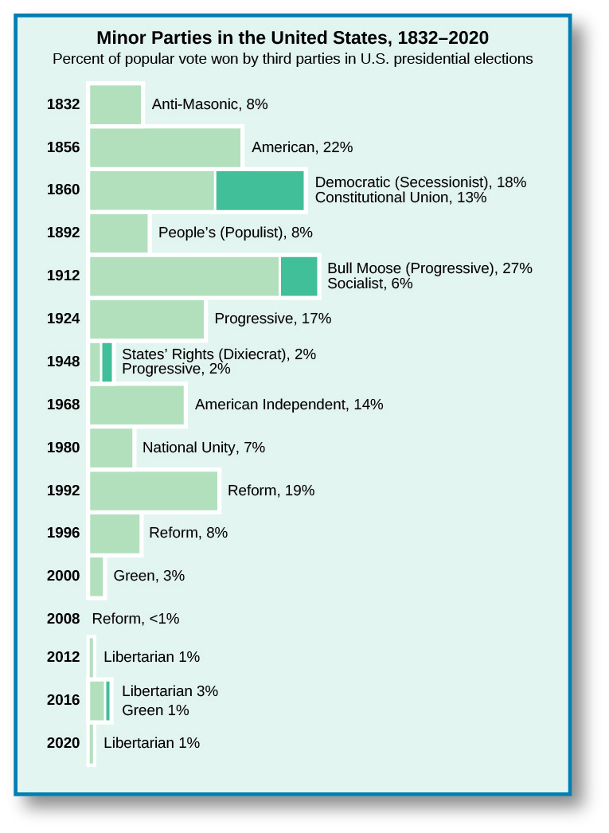
Third Parties
https://youtu.be/k06FPs04u3I
Various third parties, also known as minor parties, have appeared in the United States over the years. Some, like the Socialist Party, still exist in one form or another.
https://www.c-span.org/clip/campaign-2024/vermin-supreme-2023/5096806
Teddy Roosevelt: Bull Moose, 1912
Campaign Reform, Woman’s Suffrage, Social Insurance, 8 hour work day.
Ross Perot: Reform Party, 1992
Reduce National Debt, Campaign Finance Reform, Term Limits

Slide 44
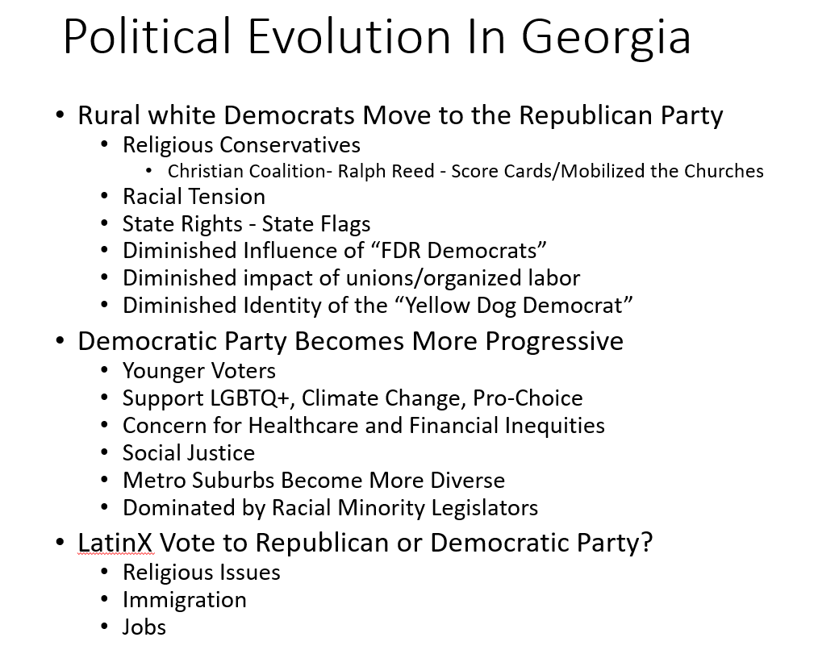

Slide 45
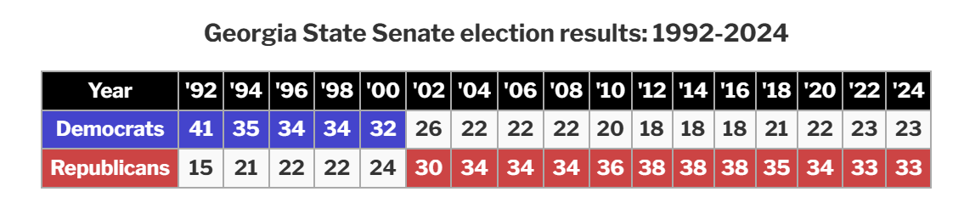
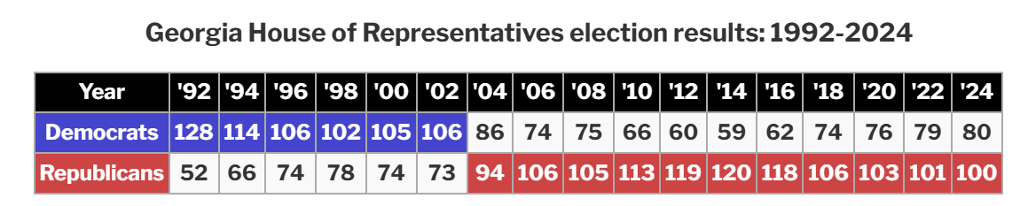
Georgia Party Transition: Timeline

Slide 47



2001
Democratic Governor Roy Barnes Leads Effort to Change the State Flag in 2001
1956 - 2000
2000 - 2003
2004 - Present

Slide 48
Turnings (not on the test)
https://www.youtube.com/watch?v=xeVyfiP0cLk&ab_channel=VanNeistat

Slide 49
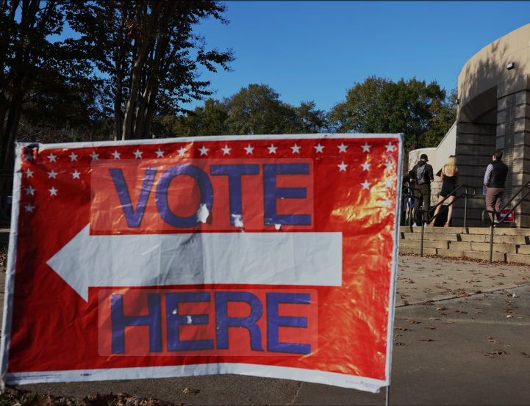
Elections

Slide 50
Types of Elections in the U.S.
Primary Elections
      Open
    Closed
    Blanket/Jungle
General Elections
Majority
  Run-Offs
  https://youtu.be/CN4BIqMyTAk
Plurality
Rank Choice Voting
https://youtu.be/oHRPMJmzBBw

Slide 51
Presidential Elections and The Electoral College
How are Presidents Elected
https://youtu.be/WfrXIGclkLA (to 5:00min)
Electoral College
https://youtu.be/ajavsMbCapY (up to 4:30min)

Slide 52
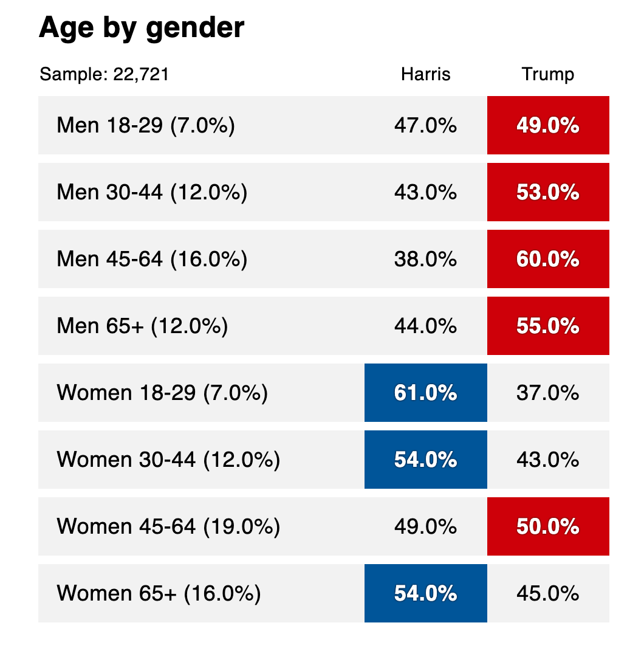
Voting Patterns

Slide 53
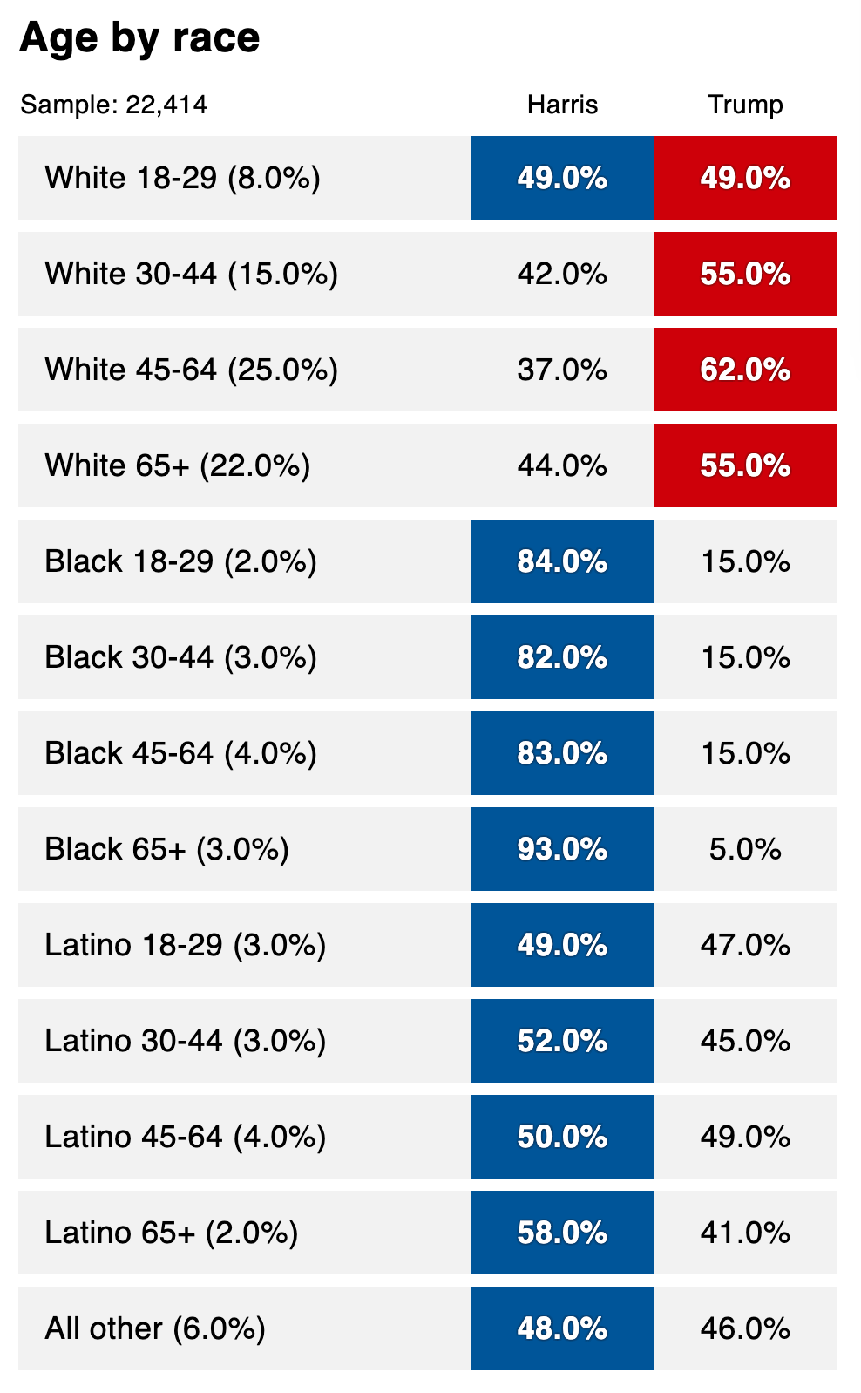
Voting Patterns

Slide 54
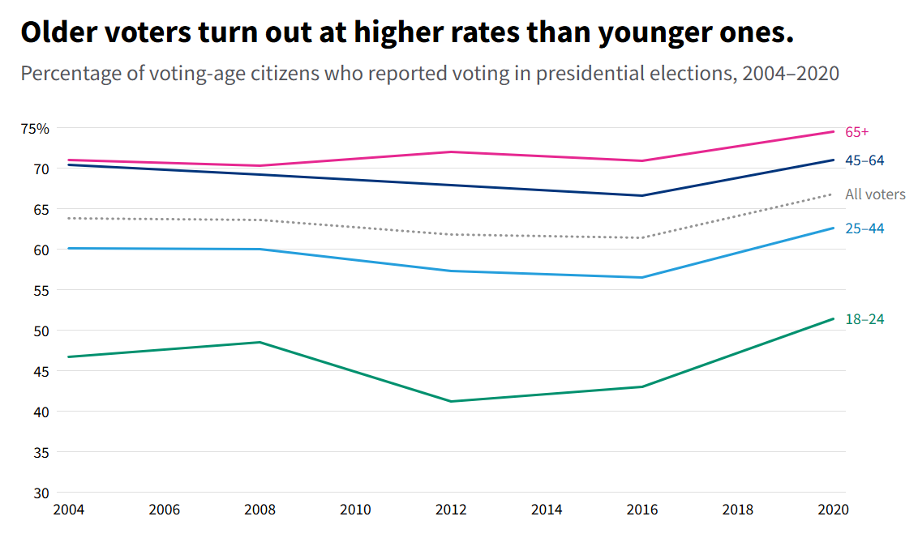
Voting Patterns
https://youtu.be/T2jwSUhu7ok

Slide 55
Test Rules
1. No Notes
2. Test is in-class. Attendance will be taken. Anyone not in attendance will not receive a grade for the test.
3. International Students: Raise your hand if there are terms you don't understand.
4. DO NOT leave the Canvas browser. Your test will be flagged and you will receive a 0. If you lose connection, there will be a pad in the front to write down your name.
5. Unless with permission, all tests must be completed by the end of class (12:15pm)
6. If you miss the test due to illness, personal crisis or travel, coordinate with Marquise on taking the test.
7. You will get your grade upon completing the test. However, specific questions that you got incorrect will not be shown until everyone has taken the test

